Slide 1
Brief Study on RK3399Pro and RK1808
Alan Zhang
2019/05

Slide 2
Agenda
RK3399, 3399Pro, 3588 Spec
RK3399Pro Functional Block Diagram
Reference Performance
ARM ML Portfolio

Slide 3
Spec | RK3399 (28nm) | RK3399Pro (28nm) | RK3588 (8nm) | Remark
CPU | Dual A72@1.8GHz + Quad A53@1.4GHz | Dual A72@1.8GHz + Quad A53@1.4GHz | Quad A76 + Quad A55 8nm | RK3588 Sample in Q3, 2019 MP in Q1, 2020
GPU | Mali-T860MP4@650MHz | Mali-T860MP4@650MHz | Mali G52
MEMORY | DDR3/3L,LPDDR3/4 eMMC 5.1/5.0 SD 3.0/MMC 4.51 x 2 | DDR3/3L,LPDDR3/4 eMMC 5.1/5.0 SD 3.0/MMC 4.51 x 2
NPU | N/A | 3.0TOPs | NPU 2.0
Video Codec | Decode: MPEG-1/2/4: 1080p60 H.263: 720 x 576@60 H.264: 4096 x 2304@60 H.265/HEVC: 4096 x 2304@60 VP8: 1080p60 VP9: 4096 x 2304@60 VC-1: 1080p60 MVC: 1080p60 Encode: H.264: 1080p30 MVC: 1080p30 VP8: 1080p30 | Decode: MPEG-1/2/4: 1080p60 H.263: 720 x 576@60 H.264: 4096 x 2304@60 H.265/HEVC: 4096 x 2304@60 VP8: 1080p60 VP9: 4096 x 2304@60 VC-1: 1080p60 MVC: 1080p60 Encode: H.264: 1080p30 MVC: 1080p30 VP8: 1080p30
DISPLAY | MIPI-DSI x 2, eDP 1.3v x 1, DP 1.2v x 1, HDMI 1.4/2.0v x 1 | MIPI-DSI x 2, eDP 1.3v x 1, DP 1.2v x 1, HDMI 1.4/2.0v x 1
CAMERA | MIPI-CSI x 2, ISP x 2, max. resolution 13M Pixel | MIPI-CSI x 2, ISP x 2, max. resolution 13M Pixel
AUDIO | I2S/PCM x 2, SPDIF x 1 | I2S/PCM x 2, SPDIF x 1

Slide 4
Spec | RK3399 (28nm) | RK3399Pro (28nm) | RK3588 (8nm) | Remark
SYSTEM COMPONENT | Timer x 26, PWM x 4, WatchDog x 3, PMU 6 voltage domains + 30 power domains, Cortex-M0 x 2 | Timer x 26, PWM x 4, WatchDog x 3, PMU 6 voltage domains + 30 power domains, Cortex-M0 x 2
Type-C | Type-C PHY x 2 Compliant with USB Type-C rev. 1.1 Compliant with USB Power Delivery Specification, revision 2.0 USB3.0 Type-C and DisplayPort 1.2 Alt Mode on USB Type-C. Up to 5Gbps data rate for USB3.0 Up to 5.4Gbps(HBR2) data rate for DP1.2, can support 1/2/4 lane mode | Type-C PHY x 2 Compliant with USB Type-C rev. 1.1 Compliant with USB Power Delivery Specification, revision 2.0 USB3.0 Type-C and DisplayPort 1.2 Alt Mode on USB Type-C. Up to 5Gbps data rate for USB3.0 Up to 5.4Gbps(HBR2) data rate for DP1.2, can support 1/2/4 lane mode
CONNECTIVITY | SDIO ver.3.0/MMC ver. 4.51 x 2, GMAC 10/100/1000M x 1, SPI x 6, UART x 5, i2c x 9, USB 2.0 Host x 2, USB OTG 3.0 x 2, PCIe rev. 2.1 x 1 | SDIO ver.3.0/MMC ver. 4.51 x 2, GMAC 10/100/1000M x 1, SPI x 6, UART x 5, i2c x 9, USB 2.0 Host x 2, USB OTG 3.0 x 2, PCIe rev. 2.1 x 1
MISC | TS-ADC x 2, SAR-ADC x 6, eFuse (32 x 32, 1024 bit) x 2 | TS-ADC x 2, SAR-ADC x 6, eFuse (32 x 32, 1024 bit) x 2
OS | Ubuntu, Debian, Arch, and Android | Ubuntu, Debian, Arch, and Android |  | http://opensource.rock-chips.com/wiki_Linux_SDK
RKNN-Toolkit Rock-X SDK | N/A | Framework supported: Tensorflow, TFLite, ONNX, Darknet, Caffe w/ INT8/INT16/FP16 hybrid operation to optimize performance, power consumption and operation accuracy. Rock-X SDK: AI 组件库，包括：人脸检测/识别/属性分析/特征点、活体检测、人头检测、人体骨骼关键点、手指关键点、人车物检测等功能，在嵌入式产品中离线地使用这些功能。 |  | https://github.com/rockchip-toybrick/RKNPUTool/tree/master/rknn-toolkit https://github.com/rockchip-toybrick/RKNPUTool/tree/master/rknn-api

Slide 5
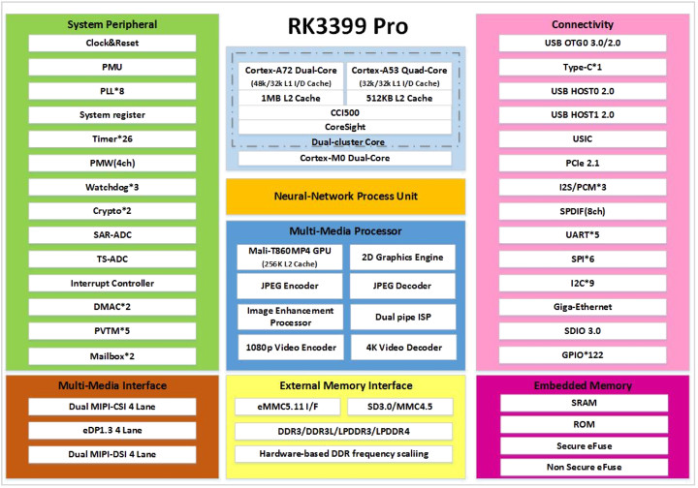
RK3399pro = RK3399 + RK1808
Notes:
RK1808 (22nm FD-SOI process, CPU上采用双核Cortex-A35架构，内置2MB系统级SRAM，可实现always-on设备无DDR运行) has 8 UART and 12 channel PWM. Apparently the targeting market is the industrial control and robotics. RK3399 and RK1808 communicate via USB3 bus, that’s why one USB3 is missing in RK3399pro exported.
RK1808 Linux BSP + SDK: https://www.cnx-software.com/2019/04/30/rockchip-rk1808-npu-datasheet-trm-board-schematics-linux-sdk/

Slide 6
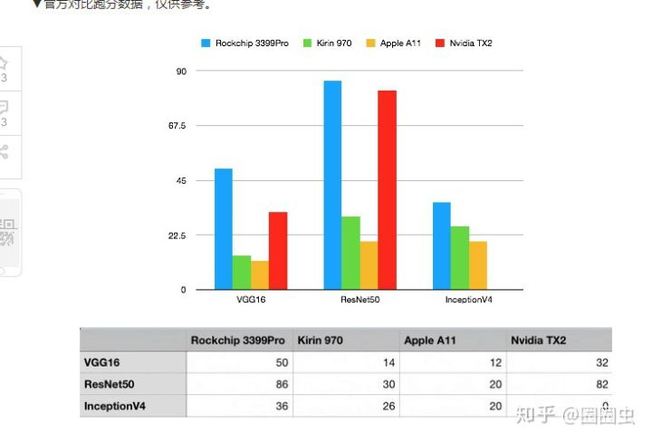
Reference Data

Slide 7
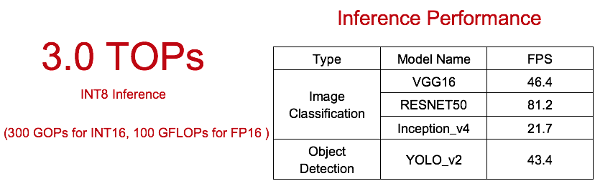
Benchmark

Slide 8
ARM Machine Learning Portfolio
Project Trillium, Arm’s Machine Learning (ML) platform, enables a new era of advanced, ultra-efficient inference at the edge. Specifically designed for ML and neural network (NN) capabilities, the architecture is versatile enough to scale to any device, from IoT to connected cars and servers.
Arm ML Processor | Arm Cortex-A Series | Arm Cortex-R Series | Arm Cortex-M Series | Arm NN | Arm Compute Lib

Slide 9
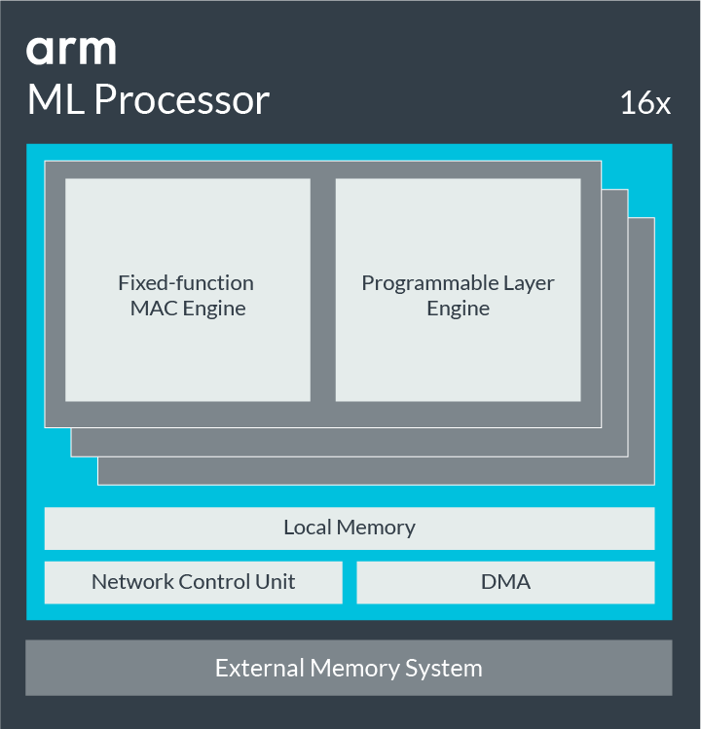
Arm ML Processor
Key Features | Performance (at 1Ghz) | 4 TOP/s
 | Data Types | Int-8 and Int-16
 | Network Support | CNN and RNN
 | Efficient Convolution | Winograd support
 | Sparsity | Yes
 | Secure Mode | TEE or SEE
 | Multi-Core Capability | 8 NPUs in a cluster 64 NPUs in a mesh
Memory System | Embedded SRAM | 1MB
 | Bandwidth Reduction | Extended compression technology, layer/operator fusion
 | Main Interface | 1xAXI4 (128-bit), ACE-5 Lite
Development Platform | Neural Frameworks | TensorFlow, TensorFlow Lite, Caffe2, PyTorch, MXNet, ONNX
 | Neural Operator API | ArmNN, AndroidNN
 | Software Components | ArmNN, neural compiler, driver and support library
 | Debug and Profile | Layer-by-layer visibility
 | Evaluation and Early Prototyping | Arm Juno FPGA systems and cycle models

Slide 10
Arm Cortex-A Series (Armv7-A)
Feature | Cortex-A5 | Cortex-A7 | Cortex-A9 | Cortex-A15 | Cortex-A17
Instruction set architecture and extensions | Armv7-A | Armv7-A LPAE Virtualization | Armv7-A | Armv7-A LPAE Virtualization | Armv7-A LPAE Virtualization
Pipeline | In order | In order | Out of order | Out of order | Out of order
Superscalar | No | Partial | Yes | Yes | Yes
Neon and Floating Point Unit | Optional | Optional | Optional | Optional | Included
Floating Point Unit only | Optional | Optional | Optional | Optional | Included
Cryptography Unit | No | No | No | No | No
Physical Addressing (PA) | 32-bit | 40-bit | 32-bit | 40-bit | 40-bit
Dual Core Lock-Step (DCLS) | No | No | No | No | No
L1 I-Cache / D-Cache | 4k-64k | 8k-64k | 16k-64k | 32kB/32kB | 32k-64k/32k
L2 Cache | External L2C-310 | Up to 1MB | External L2C-310 | 512kB-4MB | 256kB-8MB
L3 Cache | NA | NA | NA | NA | NA
ECC / Parity |  | No | Yes | Yes | L2 only
LPAE | No | Yes | No | Yes | Yes
Bus Interfaces | AXI | ACE | AXI | ACE or CHI | ACE
ACP | Optional | No | Optional | Optional | Optional
Peripheral Port |  |  | No | No | Yes
Functional Safety Support
Security | TrustZone | TrustZone | TrustZone | TrustZone | TrustZone
Interrupt Controller | Optional Integrated GIC v1 (MP only) | Optional Integrated GIC v2 | Internal Integrated GIC v1 (MP only) | Optional Integrated GICv2 | External GICv2
Generic Timer | No | Yes | Yes | Armv8-A | Armv8-A
Notes:
Reference:
https://developer.arm.com/ip-products/processors/cortex-a

Slide 11
Arm Cortex-A Series (Armv8-A)
Feature | Cortex-A32 | Cortex-A34 | Cortex-A35 | Cortex-A53 | Cortex-A55 | Cortex-A57 | Cortex-A65 | Cortex-A65AE | Cortex-A72 | Cortex-A73 | Cortex-A75 | Cortex-A76 | Cortex-A76AE | Cortex-A77
Instruction set architecture and extensions | Armv8-A AArch32 only | Armv8-A AArch64 only | Armv8-A | Armv8-A | Armv8-A, Armv8.1 extensions, Armv8.2 extensions, Cryptography extensions, RAS extensions, Armv8.3 (LDAPR instructions only), Armv8.4 Dot Product | Armv8-A | Armv8-A, Armv8.1 extensions, Armv8.2 extensions, Cryptography extensions, RAS extensions, Armv8.3 (LDAPR instructions only) | Armv8-A, Armv8.1 extensions, Armv8.2 extensions, Cryptography extensions, RAS extensions, Armv8.3 (LDAPR instructions only), Armv8.4 Dot Product | Armv8-A | Armv8-A | Armv8-A, Armv8.1 extensions, Armv8.2 extensions, Cryptography extensions, RAS extensions, Armv8.3 (LDAPR instructions only), Armv8.4 Dot Product | Armv8-A, Armv8.1 extensions, Armv8.2 extensions, Cryptography extensions, RAS extensions, Armv8.3 (LDAPR instructions only), Armv8.4 Dot Product | Armv8-A, Armv8.1 extensions, Armv8.2 extensions, Cryptography extensions, RAS extensions, Armv8.3 (LDAPR instructions only), Armv8.4 Dot Product | Armv8-A, Armv8.1 extensions, Armv8.2 extensions, Cryptography extensions, RAS extensions, Armv8.3 (LDAPR instructions only), Armv8.4 Dot Product
Pipeline | In order | In order | In order | In order | In order | Out of order | Out of order | Out-of-order | Out of order | Out of order | Out-of-order | Out-of-order | Out-of-order | Out-of-order
Superscalar |  |  |  | Yes | Yes | Yes | Yes | Yes | Yes | Yes | Yes | Yes | Yes | Yes
Neon and Floating Point Unit | Optional | Optional | Optional | Optional | Optional | Included | Included | Included | Included | Included | Included | Included | Included | Included
Floating Point Unit only | N/A | N/A | N/A | N/A | Optional | Included | Included | Included | Included | Included | Included | Included | Included | Included
Cryptography Unit | Optional | Optional | Optional | Optional | N/A | Optional | Optional | Optional | Optional | Optional | Optional | Optional | Optional | Optional
Physical Addressing (PA) | 40-bit | 40-bit | 40-bit | 40-bit | 40-bit | 40-bit | 44-bit | 44-bit | 40-bit | 40-bit | 44-bit | 40-bit | 40-bit | 40-bit
Dual Core Lock-Step (DCLS) | No | No | No | No | No | No | No | Yes (in safety-mode) | No | No | No | No | Yes (in safety-mode) | No
L1 I-Cache / D-Cache | 8k-64k | 8k-64k | 8k-64k | 8k-64k | 16kB-64kB | 48kB/32kB | 16KB to 64KB | 16KB to 64KB | 48KB/32kB-64kB | 32k/32k-64k | 64KB | 64KB | 64KB | 64KB
L2 Cache | 128KB-1MB | 128KB-1MB | 128KB-1MB | 128KB-2MB | 64kB-256kB | 512kB-2MB | 64KB to 256KB | 64KB to 256KB | 512kB-4MB | 256k-8MB | 256KB to 512KB | 256KB to 512KB | 256KB to 512KB | 256KB to 512KB
L3 Cache | NA | NA | NA | NA | Optional From 256kB to 4MB | NA | Optional 512KB to 4MB | Optional 512KB to 4MB | NA | NA | Optional 512KB to 4MB | Optional 512KB to 4MB | Optional 512KB to 4MB | Optional 512KB to 4MB
ECC / Parity | Yes | Yes | Yes | Yes | Yes | Yes | Yes | Yes | Yes | L2 only | Yes | Yes | Yes | Yes
LPAE | Yes | Yes | Yes | Yes | Yes | Yes | Yes | Yes | Yes | Yes | Yes | Yes | Yes | Yes
Bus Interfaces | ACE or CHI | ACE or CHI | ACE or CHI | ACE or CHI | ACE or CHI | ACE or CHI | ACE or CHI | ACE or CHI | ACE or CHI | ACE | ACE or CHI | ACE or CHI | ACE or CHI | ACE or CHI
ACP | Optional | Optional | Optional | Optional | Optional | Yes | Optional | Optional | Optional | Yes | Optional | Optional | Optional | Optional
Peripheral Port |  |  |  |  | Optional |  | Optional | Optional |  |  | Optional | Optional | Optional | Optional
Functional Safety Support | Yes | Yes | Yes | Yes | Yes | Yes |  | Yes | Yes |  | Yes | Yes | Yes | Yes
Security | TrustZone | TrustZone | TrustZone | TrustZone | TrustZone | TrustZone | TrustZone | TrustZone | TrustZone | TrustZone | TrustZone | TrustZone | TrustZone | TrustZone
Interrupt Controller | External GICv3 | External GICv3 | External GICv3 | External GICv3 | External GICv4 | External GICv3 | External GICv4 | External GICv4 | External GICv3 | External GICv3 | External GICv4 | External GICv4 | External GICv4 | External GICv4
Generic Timer | Armv8-A | Armv8-A | Armv8-A | Armv8-A | Armv8-A | Armv8-A | Armv8-A | Armv8-A | Armv8-A | Armv8-A | Armv8-A | Armv8-A | Armv8-A | Armv8-A
Notes:
https://developer.arm.com/ip-products/processors/cortex-a

Slide 12
Arm Cortex-R Series
Arm Cortex-R4 | Arm Cortex-R5 | Arm Cortex-R7 | Arm Cortex-R8 | Arm Cortex-R52
1.67 / 2.01 / 2.45 DMIPS/MHz* 3.47 CoreMark/MHz** | 1.67 / 2.01 / 2.45 DMIPS/MHz* 3.47 CoreMark/MHz*** | 2.50 / 2.90 / 3.77 DMIPS/MHz* 4.35 CoreMark/MHz**** | 2.50 / 2.90 / 3.77 DMIPS/MHz* 4.62 CoreMark/MHz**** | 2.16 DMIPS/MHz 4.35 CoreMarks/MHz
Lockstep configuration | Lockstep configuration Dual-core Asymmetric Multi-Processing (AMP) configuration | Lockstep configuration Dual-core Asymmetric Multi-Processing (AMP) with QoS configuration Dual core Symmetric Multi-Processing (SMP) configuration | Lockstep configuration Dual, triple or quad-core Asymmetric Multi-Processing (AMP) with QoS configuration Dual, triple or quad-core Symmetric Multi-Processing (SMP) configuration | Lockstep configuration Dual, triple or quad-core Asymmetric Multi-Processing (AMP) with QoS configuration Dual, triple or quad-core Symmetric Multi-Processing (SMP) configuration
Tightly Coupled Memory (TCM) | Tightly Coupled Memory Low Latency Peripheral Port Accelerator Coherency Port Micro Snoop Control Unit (µSCU) | Tightly Coupled Memory Low Latency Peripheral Port Accelerator Coherency Port Snoop Control Unit (SCU) | Tightly Coupled Memory Low Latency Peripheral Port Accelerator Coherency Port Snoop Control Unit (SCU) | Tightly Coupled Memory Low Latency Peripheral Port Flash Port
8-stage dual issue pipeline with instruction pre-fetch and branch prediction | 8-stage dual issue pipeline with instruction pre-fetch and branch prediction | 11-stage superscalar pipeline with out-of-order execution and register renaming and advanced dynamic and static branch prediction with instruction loop buffer | 11-stage superscalar pipeline with out-of-order execution and register renaming and advanced dynamic and static branch prediction with instruction loop buffer | 8-stage dual issue pipeline with instruction pre-fetch and branch prediction
I-Cache and D-Cache | I-Cache and D-Cache | I-Cache and D-Cache | I-Cache and D-Cache | I-Cache and D-Cache
Hardware divide, SIMD, DSP | Hardware divide, SIMD, DSP | Hardware divide, SIMD, DSP | Hardware divide, SIMD, DSP | Hardware divide, NEON
IEEE754 Double Precision FPU | IEEE754 Double Precision FPU or optimized SP Floating Point Unit | IEEE754 Double Precision FPU or optimized SP Floating Point Unit | IEEE754 Double Precision FPU or optimized SP Floating Point Unit | IEEE754 Double Precision FPU or optimized SP Floating Point Unit
Memory Protection Unit (MPU) with 8 or 12 memory regions | Memory Protection Unit (MPU) with 12 or 16 memory regions | Memory Protection Unit (MPU) with 12 or 16 memory regions | Memory Protection Unit (MPU) with 12, 16, 20 or 24 memory regions | Stage-1 Memory Protection Unit (MPU) with 0 or 16 memory regions Stage-2 Memory Protection Unit (MPU) with 0 or 16 memory regions
ECC and Parity protection on L1 memories | ECC and Parity protection on L1 memories and AXI bus ports | ECC and Parity protection on L1 memories and AXI bus ports. Error Management with error bank | ECC and Parity protection on L1 memories and AXI bus ports. Error Management with error bank | ECC and Parity protection on L1 memories and AXI bus ports Bus interconnect protection
Vectored Interrupt Controller (VIC) Port or Generic Interrupt Controller (GIC) | Vectored Interrupt Controller (VIC) or Generic Interrupt Controller (GIC) | Integrated Generic Interrupt Controller (GIC) | Integrated Generic Interrupt Controller (GIC) | Integrated Generic Interrupt Controller (GIC), 32-960 interrupts

Slide 13
Arm Cortex-M Series
Feature | Cortex-M0 | Cortex-M0+ | Cortex-M1 | Cortex-M23 | Cortex-M3 | Cortex-M4 | Cortex-M33 | Cortex-M35P | Cortex-M7
Instruction set architecture | Armv6-M | Armv6-M | Armv6-M | Armv8-M Baseline | Armv7-M | Armv7-M | Armv8-M Mainline | Armv8-M Mainline | Armv7-M
 | Thumb, Thumb-2 | Thumb, Thumb-2 | Thumb, Thumb-2 | Thumb, Thumb-2 | Thumb, Thumb-2 | Thumb, Thumb-2 | Thumb, Thumb-2 | Thumb, Thumb-2 | Thumb, Thumb-2
DMIPS/MHz range* | 0.87-1.27 | 0.95-1.36 | 0.8 | 0.99 | 1.25-1.89 | 1.25-1.95 | 1.5 | 1.5 | 2.14-3.23
CoreMark®/MHz** | 2.33 | 2.46 | 1.85 | 2.5 | 3.34 | 3.42 | 4.02 | 4.02 | 5.01
Pipeline stages | 3 | 2 | 3 | 2 | 3 | 3 | 3 | 3 | 6
Memory Protection Unit (MPU) | No | Yes (option) | No | Yes (option) (2 x) | Yes (option) | Yes (option) | Yes (option) (2 x) | Yes (option) (2 x) | Yes (option)
Maximum MPU regions | 0 | 8 | 0 | 16 | 8 | 8 | 16 | 16 | 16
Trace (ETM or MTB) | No | MTB (option) | No | MTB (option) or ETMv3 (option) | ETMv3 (option) | ETMv3 (option) | MTB (option) and/or ETMv4 (option) | MTB (option) and/or ETMv4 (option) | ETMv4 (option)
DSP | No | No | No | No | No | Yes | Yes (option) | Yes (option) | Yes
Floating point hardware | No | No | No | No | No | Yes (option SP) | Yes (option SP) | Yes (option SP) | Yes (option SP + DP)
Systick Timer | Yes (option) | Yes (option) | Yes (option) | Yes (2 x) | Yes | Yes | Yes (2 x) | Yes (2 x) | Yes
Built-in Caches | No | No | No | No | No | No | No | Yes (option 2- 16kB | Yes (option 4-64kB
 |  |  |  |  |  |  |  | I-cache | I-cache, D -cache)
Tightly Coupled Memory | No | No | Yes | No | No | No | No | No | Yes (option 0-16MB I-TCM/D-TCM)
TrustZone for Armv8-M | No | No | No | Yes (option) | No | No | Yes (option) | Yes (option) | No
Co-processor interface | No | No | No | No | No | No | Yes (option) | Yes (option) | No
Bus protocol | AHB Lite | AHB Lite, Fast I/O | AHB Lite | AHB5, Fast I/O | AHB Lite, APB | AHB Lite, APB | AHB5 | AHB5 | AXI4, AHB Lite, APB, TCM
Wake-up interrupt controller support | Yes | Yes | No | Yes | Yes | Yes | Yes | Yes | Yes
Integrated interrupt controller | Yes | Yes | Yes | Yes | Yes | Yes | Yes | Yes | Yes
Maximum # external interrupts | 32 | 32 | 32 | 240 | 240 | 240 | 480 | 480 | 240
Hardware divide | No | No | No | Yes | Yes | Yes | Yes | Yes | Yes
Single cycle multiply | Yes (option) | Yes (option) | No | Yes | Yes | Yes | Yes | Yes | Yes
CMSIS Support | Yes | Yes | Yes | Yes | Yes | Yes | Yes | Yes | Yes

Slide 14
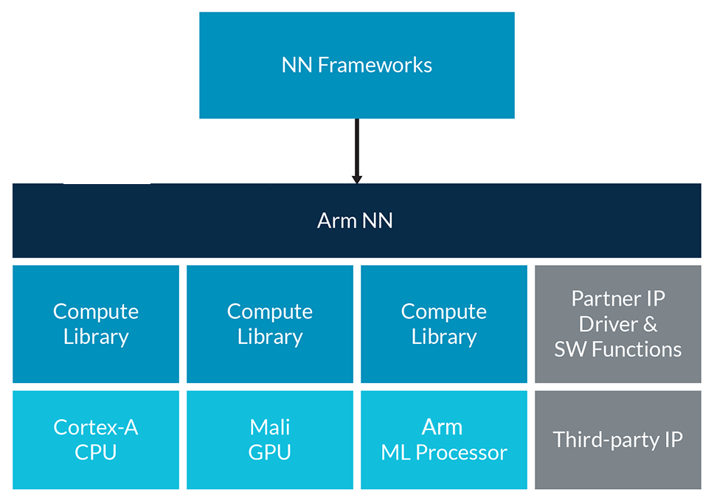
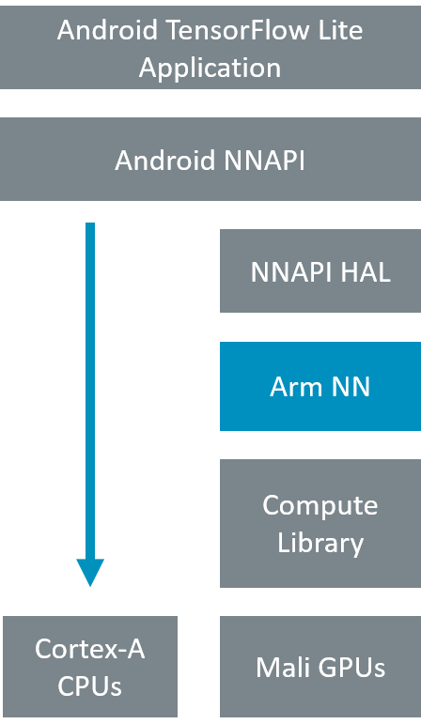
Arm NN
Arm NN SDK is a set of open-source Linux software and tools that enables machine learning workloads on power-efficient devices. It provides a bridge between existing neural network frameworks and power-efficient Cortex-A CPUs, Arm Mali GPUs and the Machine Learning processor.
In Android world, Arm claims NN has been deployed in multiple production devices (>250Mu).
Notes:
Machine learning support for Cortex-M microcontrollers is provided by TensorFlow Lite Micro. Further optimization is available via CMSIS-NN, a collection of efficient neural network kernels developed to maximize the performance and minimize the memory footprint of neural networks on Cortex-M processor cores.
Download CMSIS-NN: http://arm-software.github.io/CMSIS_5/NN/html/index.html

Slide 15
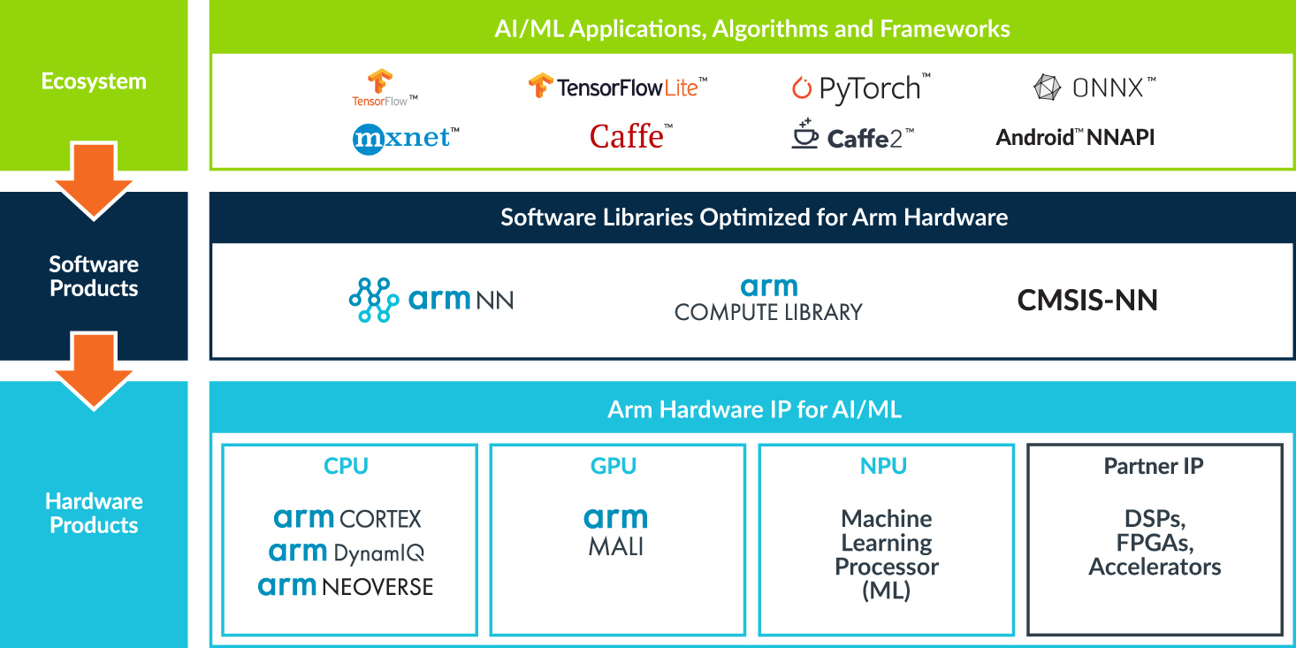
Arm NN Roadmap

Slide 16
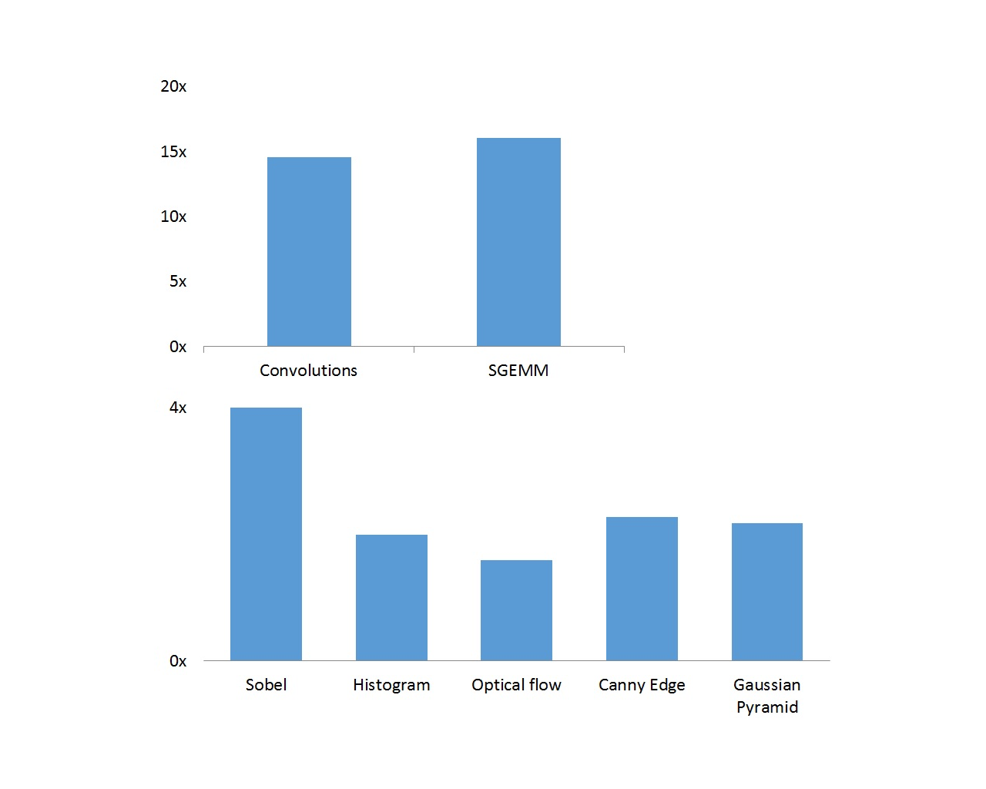
Arm Compute Library
Arm Compute Library contains a comprehensive collection of software functions implemented for the Arm Cortex-A family of CPU processors and the Arm Mali family of GPUs.
Basic arithmetic, mathematical, and binary operator functions
Color manipulation (conversion, channel extraction, and more)
Convolution filters (Sobel, Gaussian, and more)
Canny Edge, Harris corners, optical flow, and more
Pyramids (such as Laplacians)
HOG (Histogram of Oriented Gradients)
SVM (Support Vector Machines)
H/SGEMM (Half and Single precision General Matrix Multiply)
Convolutional Neural Networks building blocks (Activation, Convolution, Fully connected, Locally connected, Normalization, Pooling, Soft-max)

Slide 17
Arm ML Community
https://developer.arm.com/solutions/machine-learning-on-arm
https://community.arm.com/
https://github.com/ARM-software

Slide 18
Backup

Slide 19
Upcoming RockChip Solution
RK3588
– SoC
– 8nm processing
– Quad A76 + quad A55
– 4K UI
– NPU 2.0
– Multimedia
– 8K VPU
– ISP 2.0
– VOP 2.0
– Rich interfaces
– Applications
– General computing
– Edge computing
– Multimedia processing
RK3530
– Quad A55 CPU + Mali G52 GPU
– Suppport large DDR3, LPDDR4/LPDDR4x
– VPU 2.0, support 4K HDR, H264/265/AVS2
– HDMI/USB 3.0/SATA/GbE
– Samples available in Q3 2019
RV1109
– Dual core CPU, NPU 2.0, 14nm
– ISP2.0, dual camera input and processing
– VPU 2.0, 4K H264/265 encoding/decoding
– Samples available in Q4 2019
RK2108:
– ARM M4F + Audio DSP
– High freqence, large storage, high integration, ultra low power
– For voice/audio apllications, MCU applications
– Samples available in Q3 2019
RK912
– QFN 40
– Board level design
– WLAN802.11 b/g/n
– MP in Q2

